Slide 1
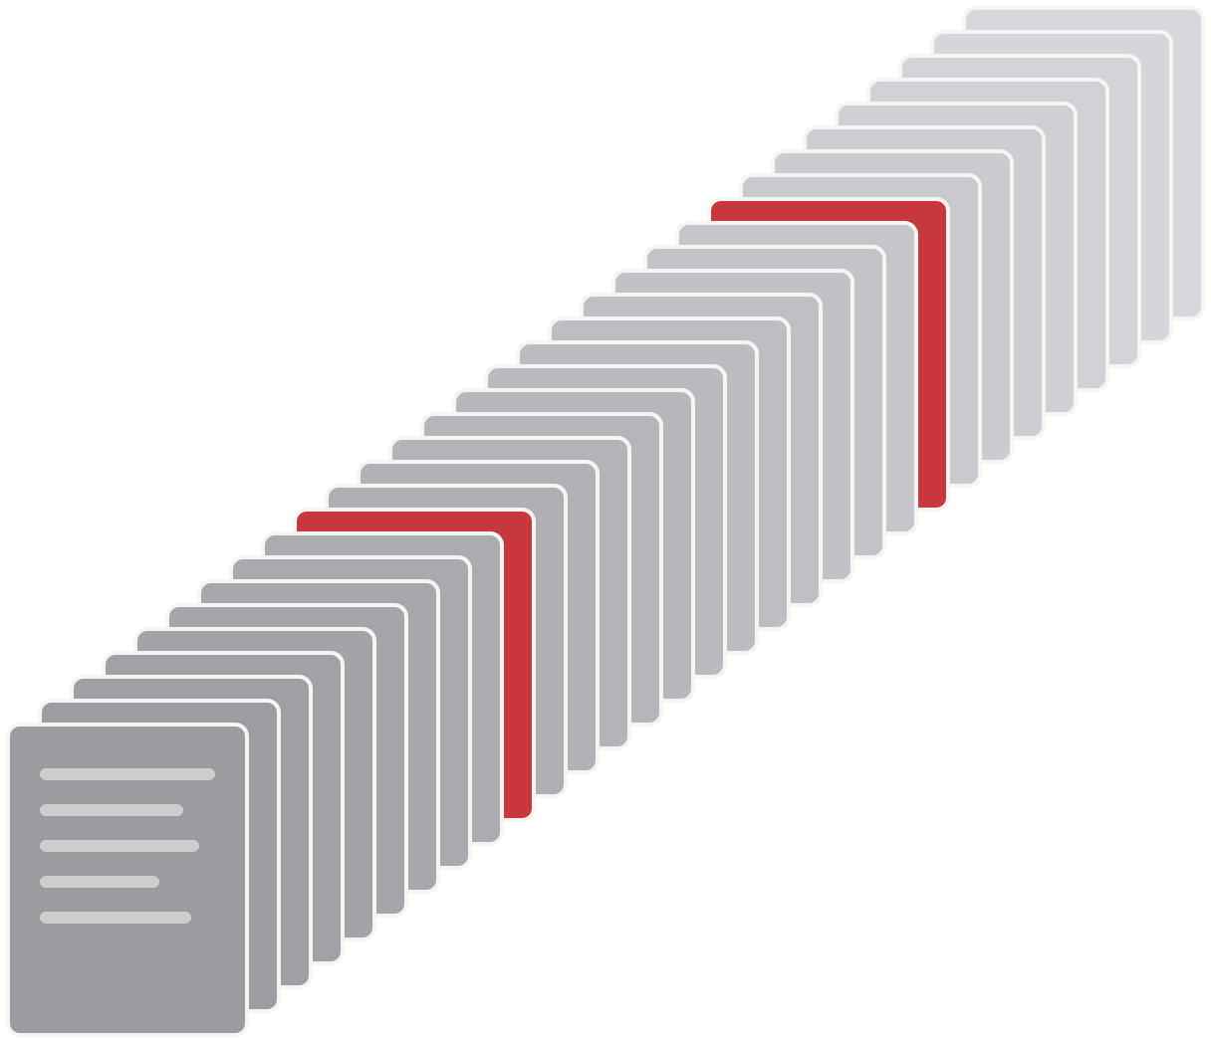
OCR GAP
2 of 31 PDFs have no text behind them
6.5%
of the corpus is invisible to retrieval
Fix OCR and add the text layer: ~+6.5% on every benchmark
29 with a text layer
2 image-only (no text)
MRR
Recall@K
Hit@K
~+6.5%
~+6.5%
~+6.5%
Notes:
31 PDFs in the set. 2 are scanned images with no extractable text, so they never match a query: 2/31 = 6.5% of the corpus. Running OCR and adding a text layer lifts MRR, Recall@K and Hit@K by roughly 6.5% each.

